Slide 1


My Chatbot
Dyches, Cade

Slide 2
Scope
The district chosen was district 10
Attempted both Java and C++

Slide 3
Data
Name
Home address
Contact Info home
Contact info business

Slide 4
Code Organization
Ending brackets to help identify loops
Created individual methods to implement them into main
PA6 switched to Java with reused code from Angela Ruth, but switched back to C++ for time constraints
Comments describe what is going on
PA1, PA2, PA3, PA4, PA5, PA6 all made put together

Slide 5
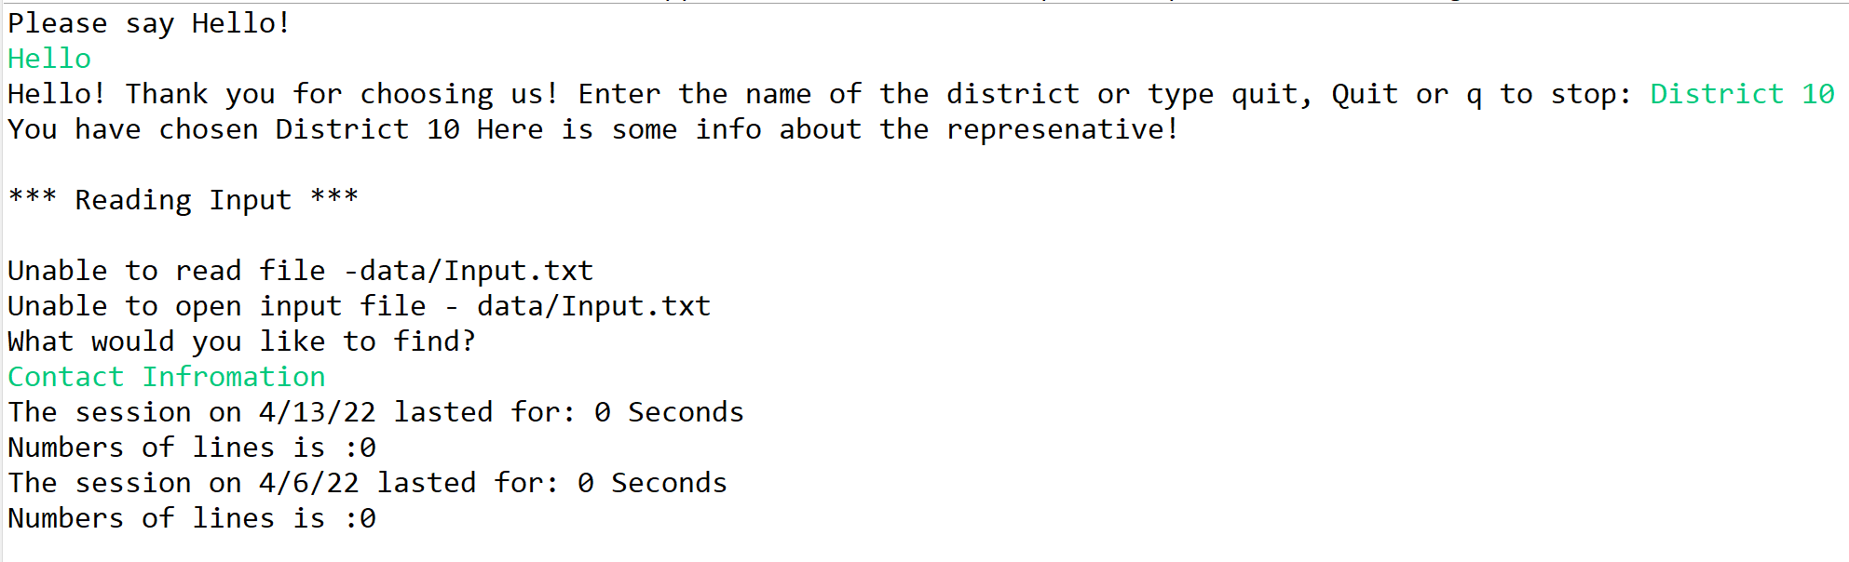
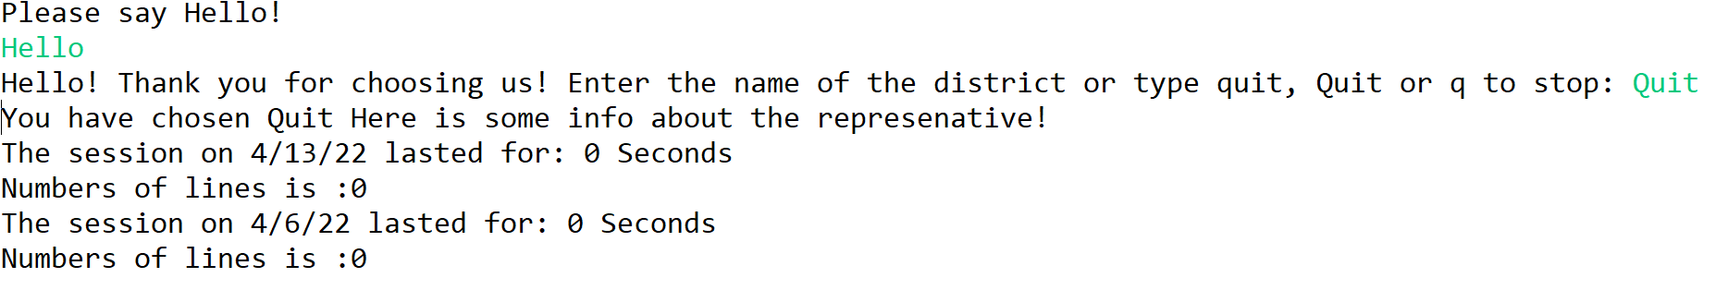
Queries
csce-240-02-spring2022-programs/Prog6.mp4 at main · cadedyches/csce-240-02-spring2022-programs (github.com)

Slide 6
Chatbot
Chatbot was made as programs were made
Implementation had little complication
During testing problems with file reader
File reader also caused problems with output file
Created own file reader

